Slide 1
EFB 390 Recitation

Slide 2
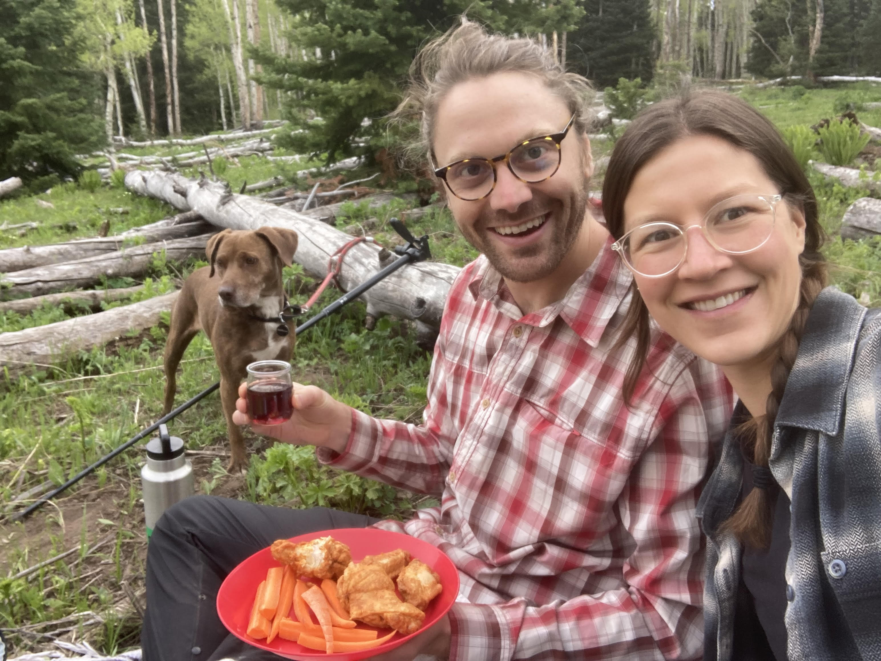
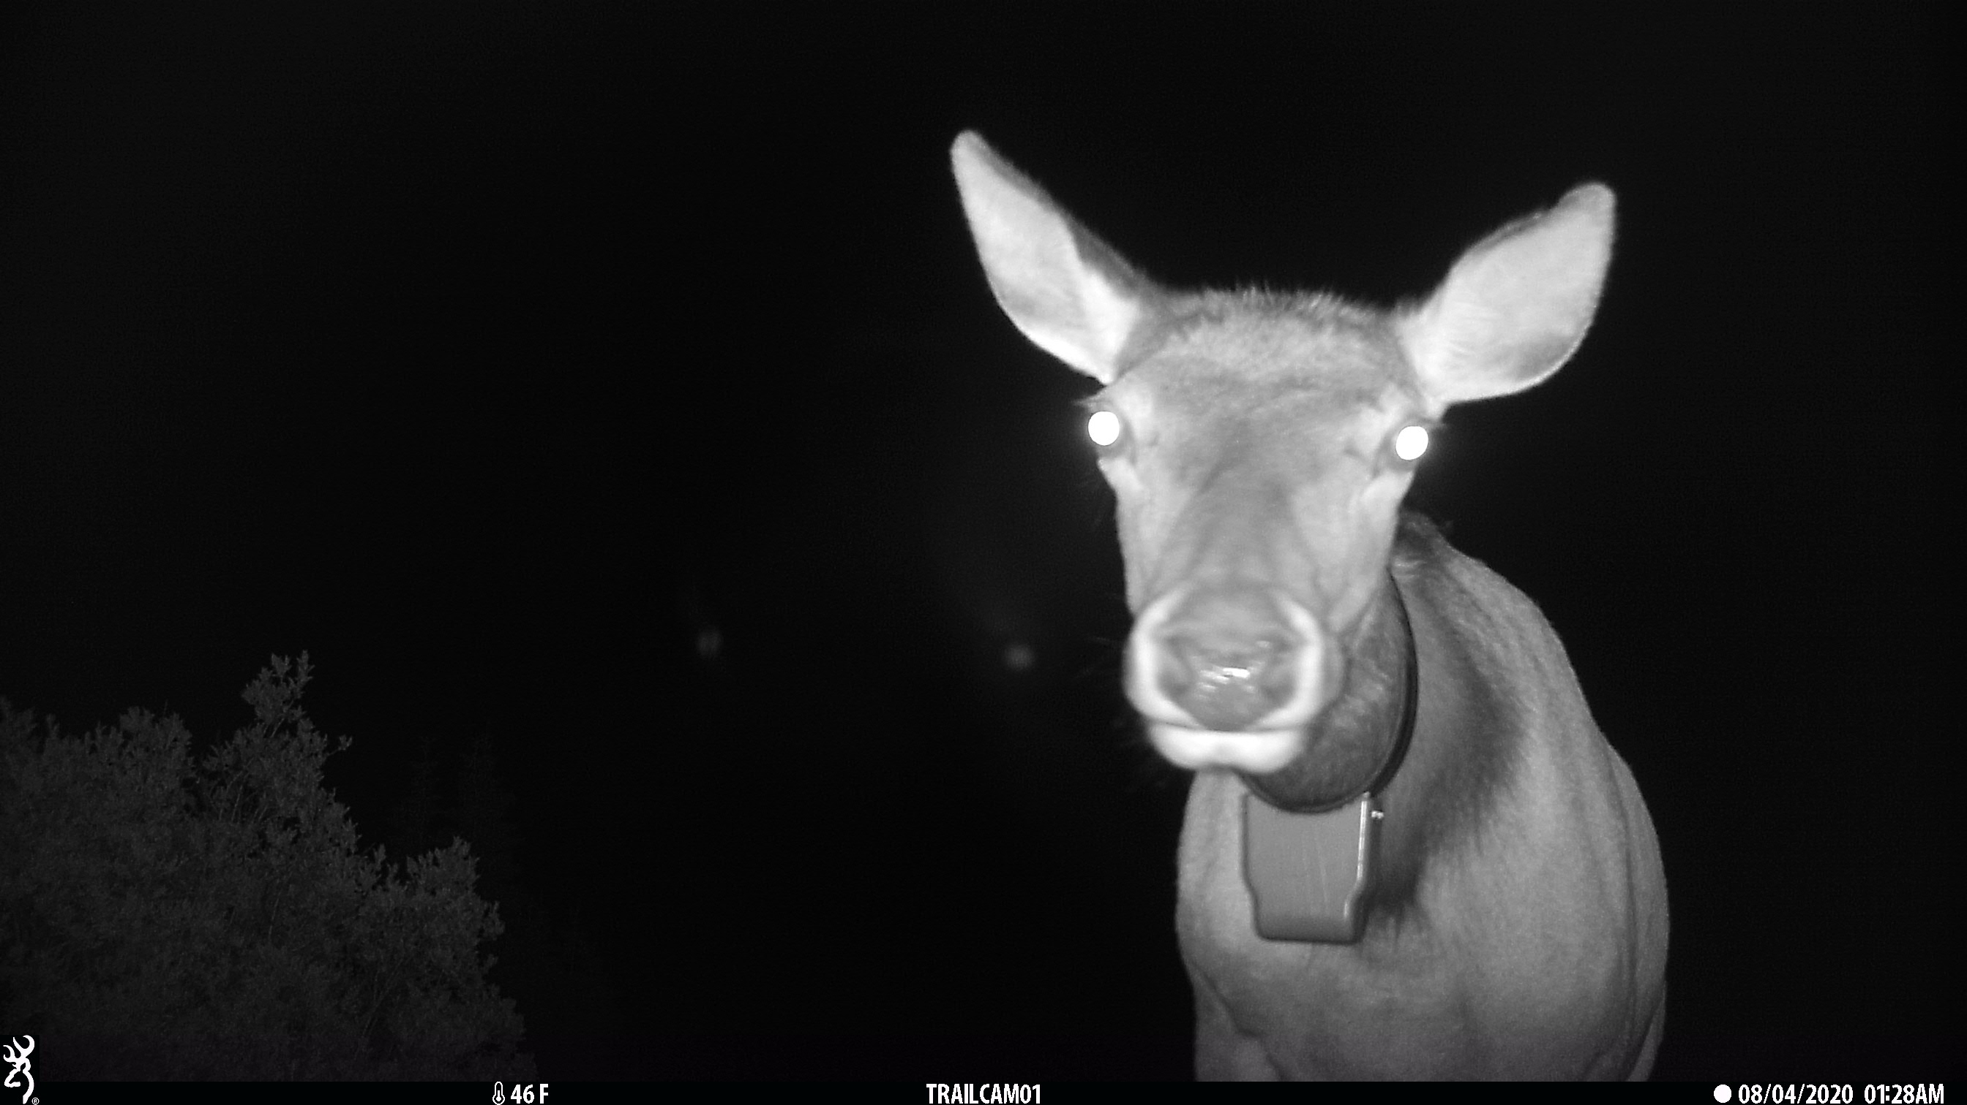
Chloe Beaupre she/her
B.S. Society & Environment - UC Berkeley
Dual masters - Western Colorado University
M.S. in Ecology - Animal Sample Size Guidelines for Mapping Migrations and Distribution with GPS Collars
Master in Environmental Management – Influence of Recreation on Deer and Elk in the Gunnison Basin
PhD – SUNY ESF –caribou movement
Office Hours: Mondays 1-2 pm in Moon Library
cbeaupre@esf.edu

Slide 3

Safe Spaces

Slide 4
Recitation sections
From syllabus:
“Lots of readings and discussions”
“Also developing and work-shopping the final projects”
Not recorded (usually)
Today:
Intros
Discuss readings (Wildlife, conservation, and human welfare: a United States and Canadian perspective)
Notes:
This is from the syllabus for what to expect in recitation
I expect you all to be here prepared, having done the readings, ready to be engaged in discussion

Slide 5
How did hunting/interactions with wildlife contribute to human development?
Bipedalism
Stereoscopic vision
Tooth structure
Tool use
Language
Human consciousness
Beliefs
Social organization

Slide 6
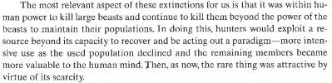
A PARADIGM!

Slide 7
What qualities should a domestic animal have?
Be hardy
Dominance social hierarchy (humans as leaders)
Easy to tend
Breed freely in captivity
Be useful to humans
In small groups, identify one species that would be easy to domesticate and one species that would be hard to domesticate and their attributes that make it easy/hard.

Slide 8
Why Old World sheep and not Bighorn sheep?
Hardy? Definitely.
Dominance social hierarchy? Harems, fight for dominance.
Easy to tend? Huge horns problematic.
Breed freely in captivity? Probably, but terrain?
Be useful to humans? No wooly coat.
Other potential issues?

Slide 9
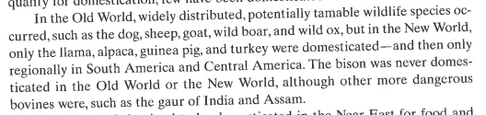
Why do we see this pattern?

Slide 10
Effects of agricultural development
Modification of the landscape
Human values concerning wildlife changed
New habitat available in farmlands (e.g rats!)
Predator control
Smaller humans
Increase of human populations

Slide 11
Assertions you don’t agree with? Missing citations?
E.g. Decreased wildlife populations near human dwellings (townie deer), Reindeer domestication and hunting aid, spacing children every four years

